Slide 1
Desktop Notifier App
Prashant Kumar
Section- B
Branch- CSE
1802910115

Slide 2
Introduction A desktop notifier is a simple application which produces a notification message in form of a pop-up message on desktop. The term desktop notifications refer to a graphical control element that communicates certain events to the user without forcing them to react to this notification immediately. In other words, it is a simple application which produces a notification message in form of a pop-up message on desktop. There are many reasons that a computer may want to notify you of things not directly related to what you are doing right now. Software updates may be available; you may have received a new instant message; your 300-page print job may have finally finished; you may have only ten minutes of battery left. Sometimes these events need a response or at least acknowledgement, or don’t need to be read immediately, in which case they should be presented in an alert box or some other window.

Slide 3
Functionality
It’s a project which is based on notifying about the current scenario of pandemic disease COVID-19 in INDIA by tracking down :-
Active Cases
Cured Cases
Deaths
Migrated

Slide 4
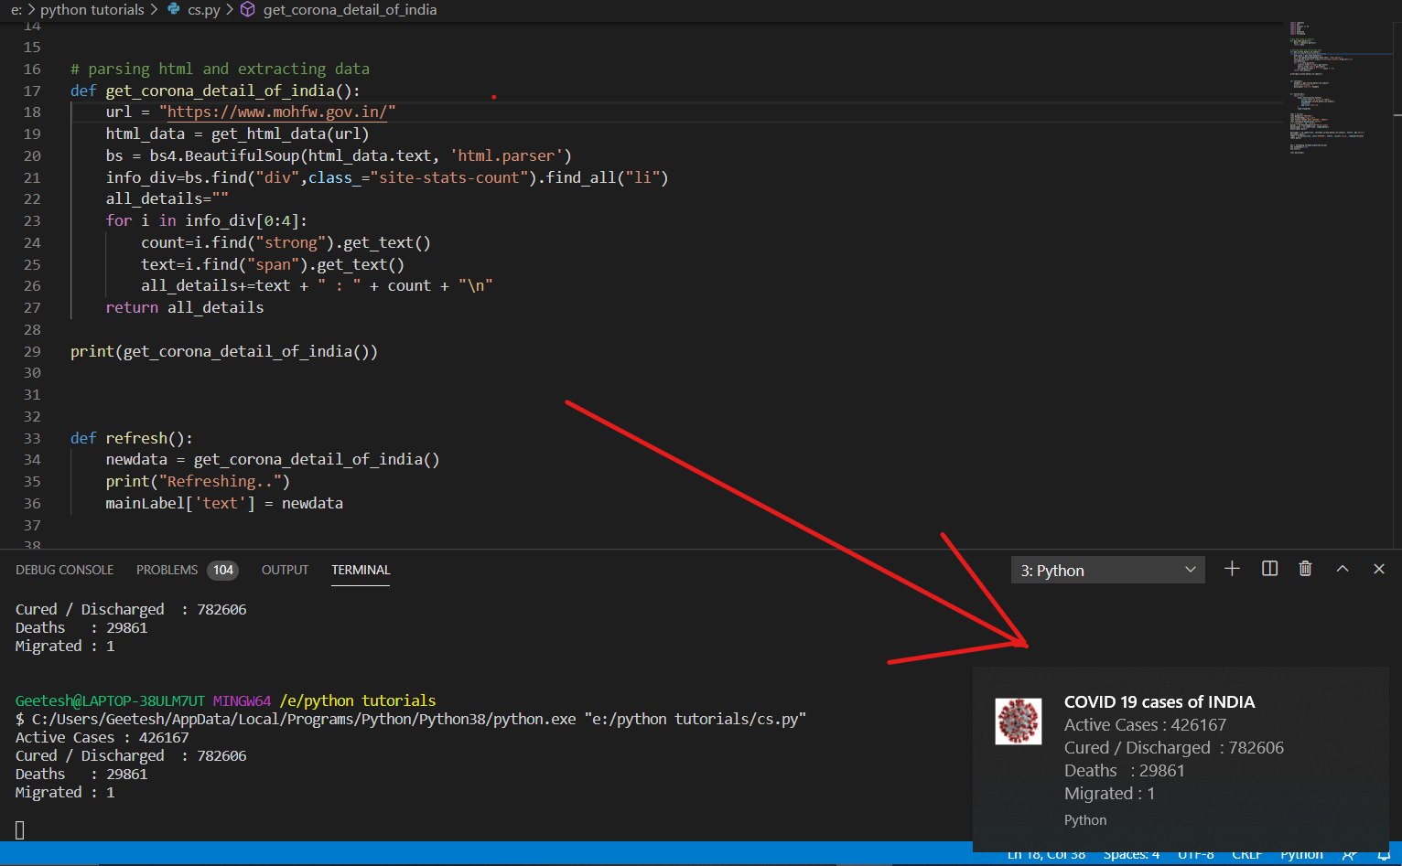
Notification

Slide 5
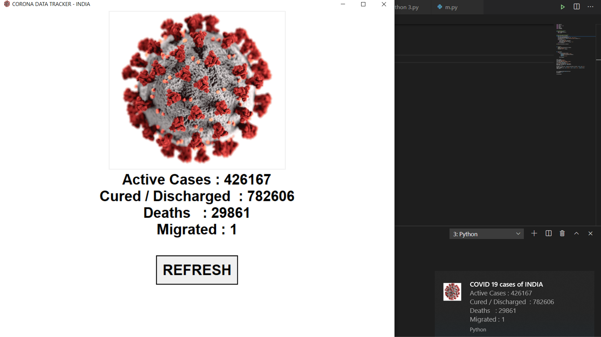
GUI

Slide 6
Tools Used:
Visual Studio Code
Git Bash
Python 3.8
Installing Moudles
References/Sources:
Coursera
YouTube
W3 School

Slide 7
PAPER DOWNLOADED FROM MYLOFT WHICH ARE REVIEWED:-
Using a Real-Time Operating System for Multitasking in Remote Patient Monitoring.
Research on Encryption Algorithm Based on Python
Automated Regression Testing and Data Analytics using Python
Study of DATA analysis model based on big data technology
Embedding Data Science into Computer Science Education

Slide 8
THANK YOU

